Slide 1

AI BASED TOOL TO ASSIST VEHICLES IN DETECTING OBJECTS TO AVOID ACCIDENTS.
Team members:
2010030536- Shravan
2010030358-Avinash
2010030513-Akhil
2010030033-Santosh
Guide :
Dr . Rama Rao

Slide 2
Tools and packages
Tools
Py-charm
Nvidia cuda
Visual studio build tools
Packages
Open-cv
Py-torch
Pandas
NumPy
Pycoco
Torch ,torch vision ,torch audio
Threadpoolctl
Scipy
Pillow

Slide 3
Capturing Images
IMAGE ENCHANCEMENT
Feeding images
Dataset loading
If fails
Dividing picture into blocks
DATASET TRAINING
Manual screening
Picture identification
IDENTIFICATION
AND DETECTION OF DATASETS
If passed
Display symbol/voice command
Final dataset
Dataset comparsion

Slide 4
DATA PRE-PROCESSING Feature Engineering
DATASET COLLECTION
DATASET CLEANING
DATASET FORMATTING

Slide 5
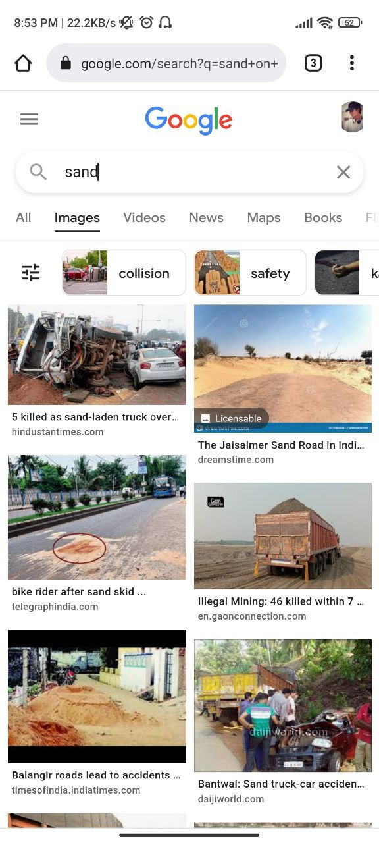
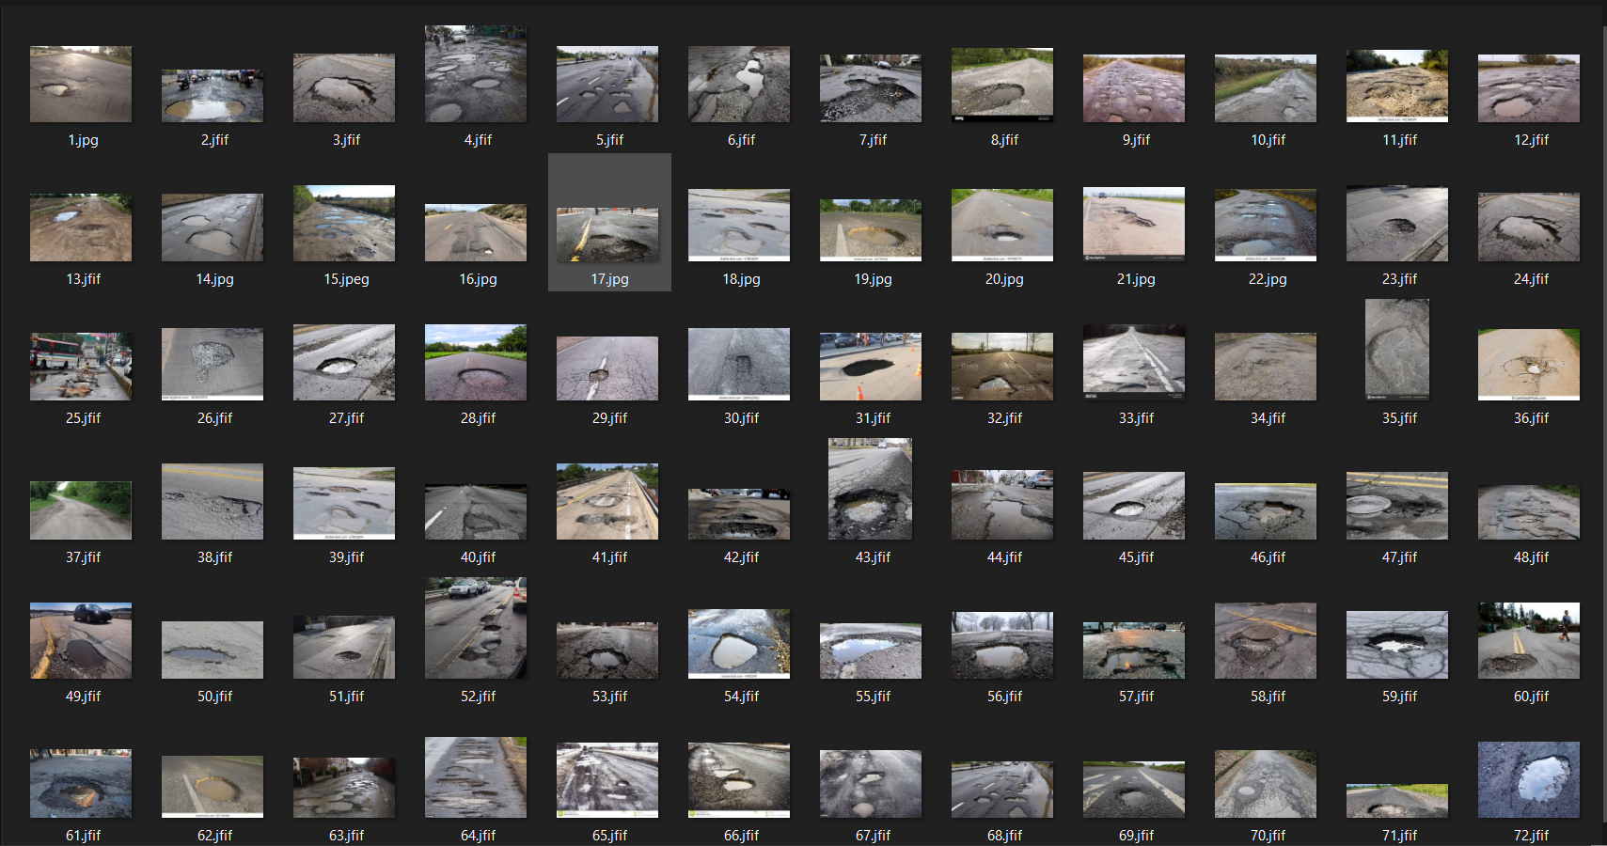
DATA SET COLLECTION
We have used open source resources like google and Kaggle to gather required datasets for our project.
In our project dataset required is in format of Images.

Slide 6
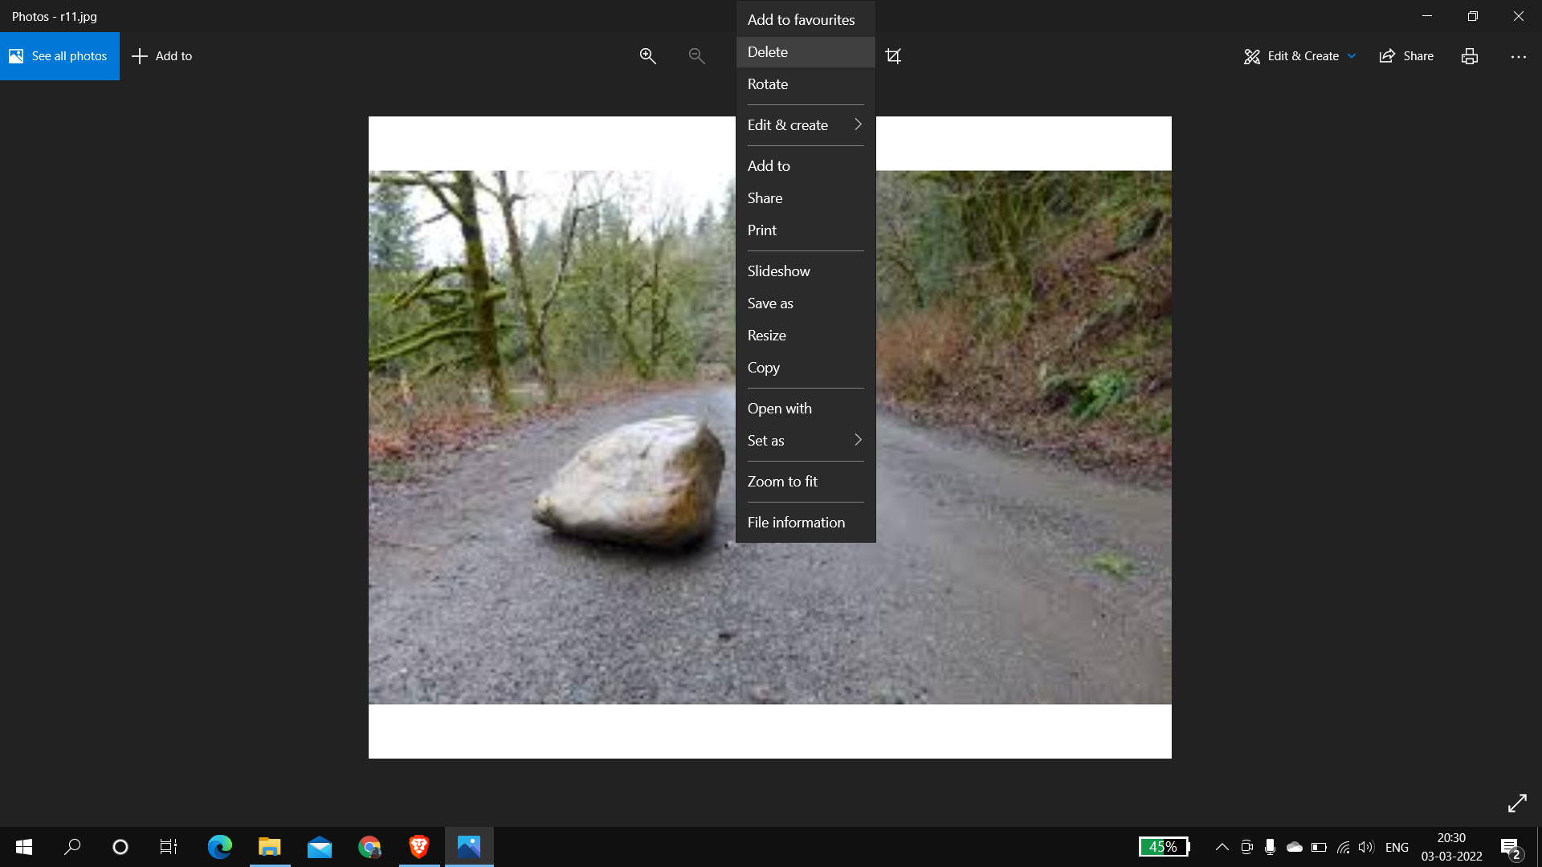
Data cleaning
We have removed unwanted and noisy data .
In our case noisy data refers to blur images , duplicate images etc..

Slide 7
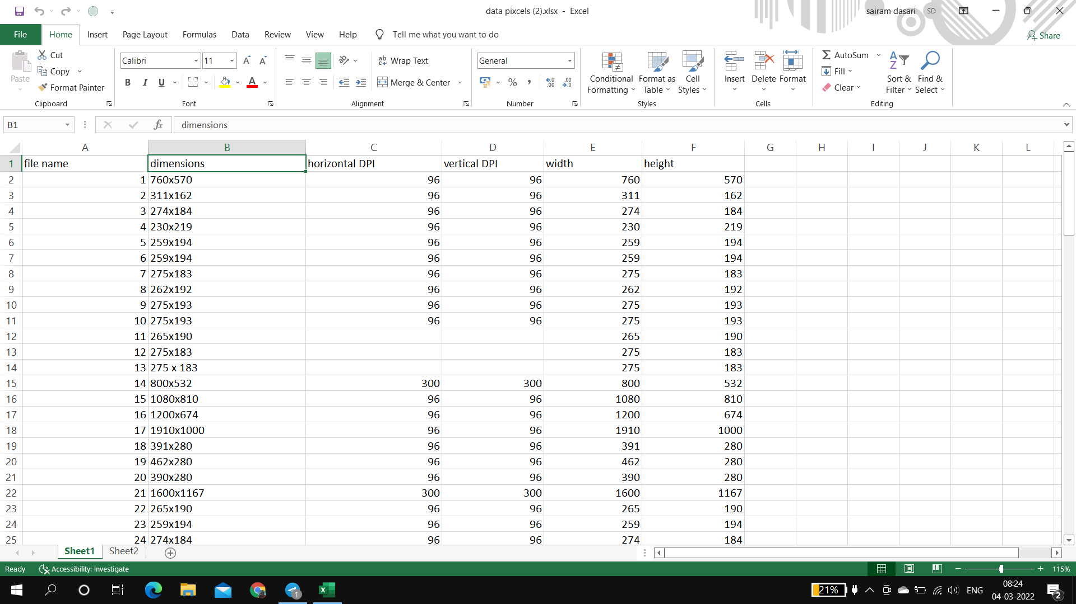
Dataset Formatting
We have rearranged the parameters for dataset into an excel sheet .
The parameters for our dataset are width ,height,dpi(dots per inch).
We have changed the parameters of images into equal dimensions.
In this case we used mode method for calculating the most repeated parameters.

Slide 8
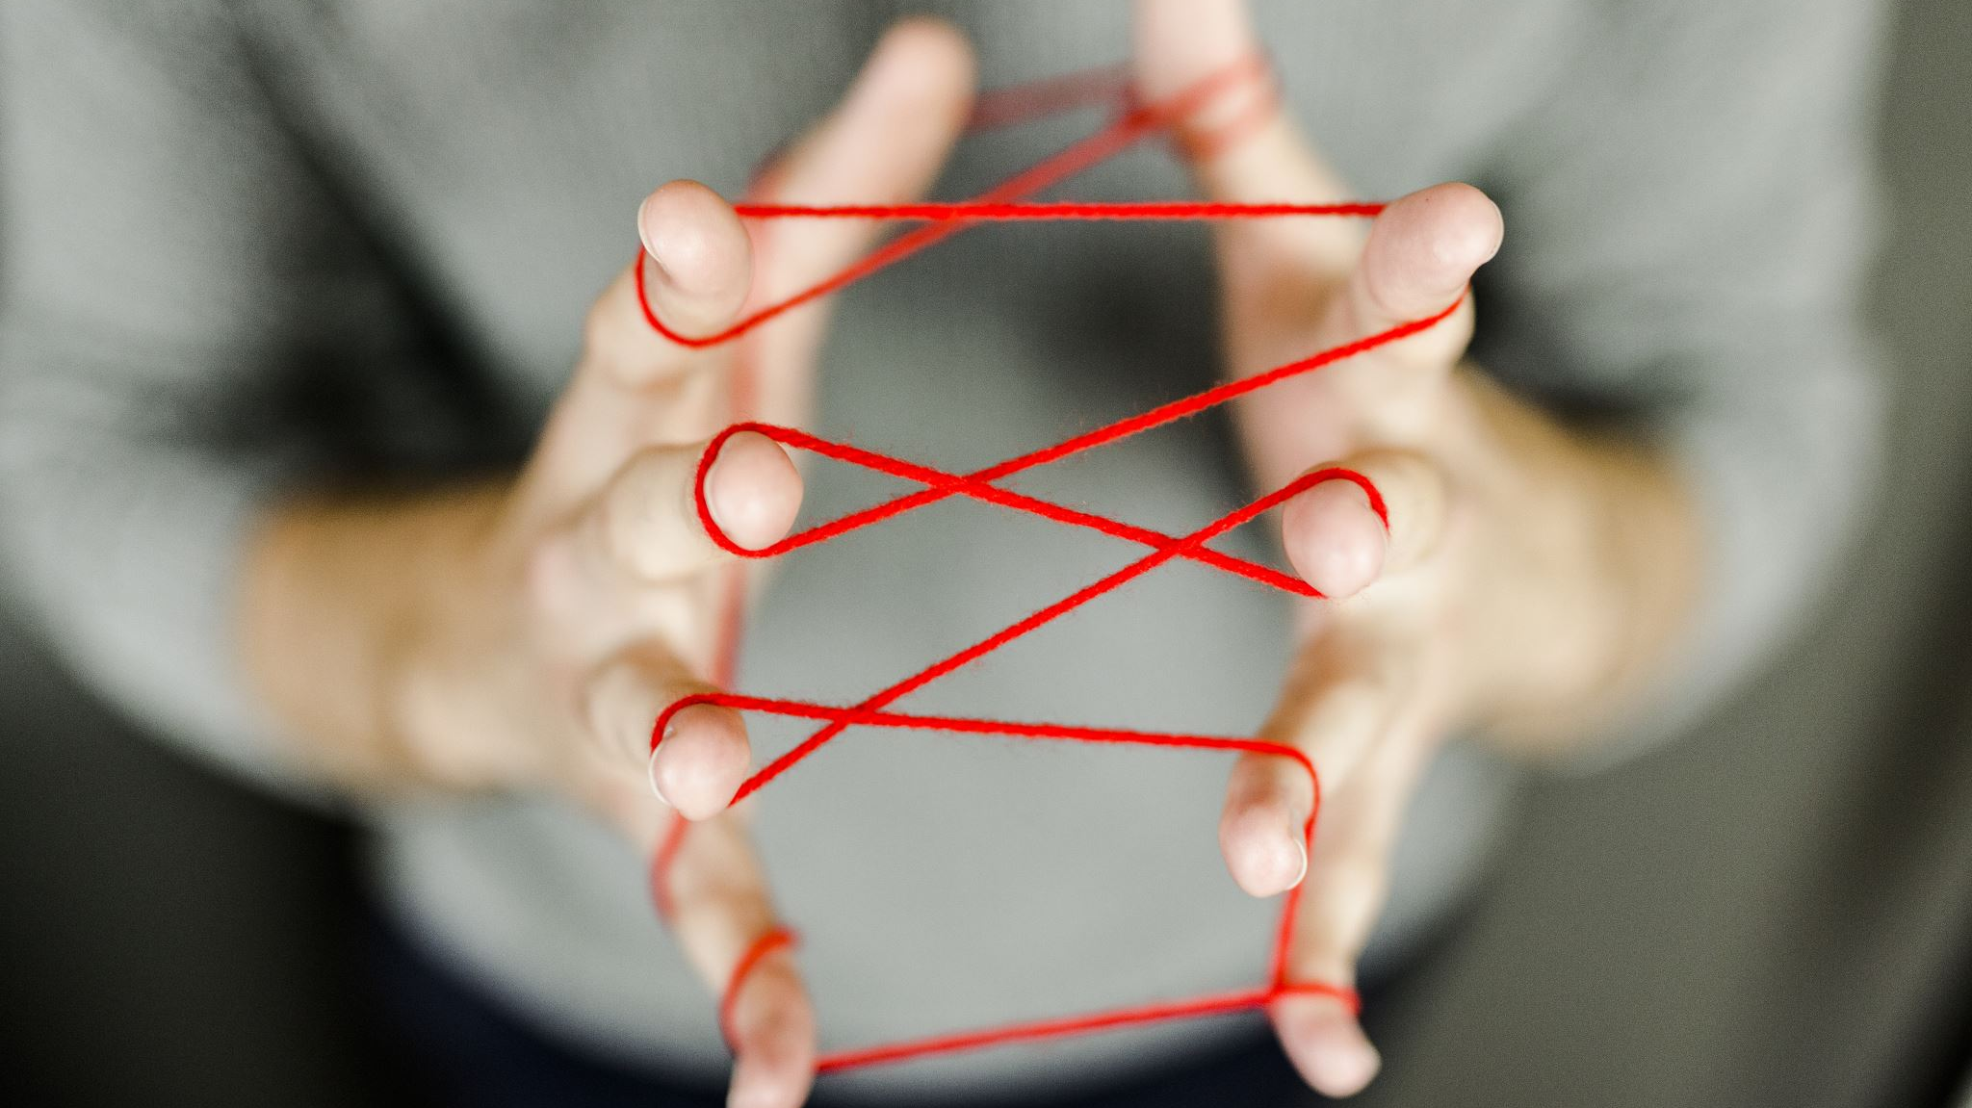
Model Training and Deployement
Model :- yolov5
Its architecture mainly consisted of three parts, namely-
1. Backbone: Model Backbone is mostly used to extract key features from an input image. CSP(Cross Stage Partial Networks) are used as a backbone in YOLO v5 to extract rich in useful characteristics from an input image.
2. Neck: The Model Neck is mostly used to create feature pyramids. Feature pyramids aid models in generalizing successfully when it comes to object scaling. It aids in the identification of the same object in various sizes and scales. Feature pyramids are quite beneficial in assisting models to perform effectively on previously unseen data. Other models, such as FPN, BiFPN, and PANet, use various sorts of feature pyramid approaches.
PANet is used as a neck in YOLO v5 to get feature pyramids.
3. Head: The model Head is mostly responsible for the final detection step. It uses anchor boxes to construct final output vectors with class probabilities, objectness scores, and bounding boxes.

Slide 9
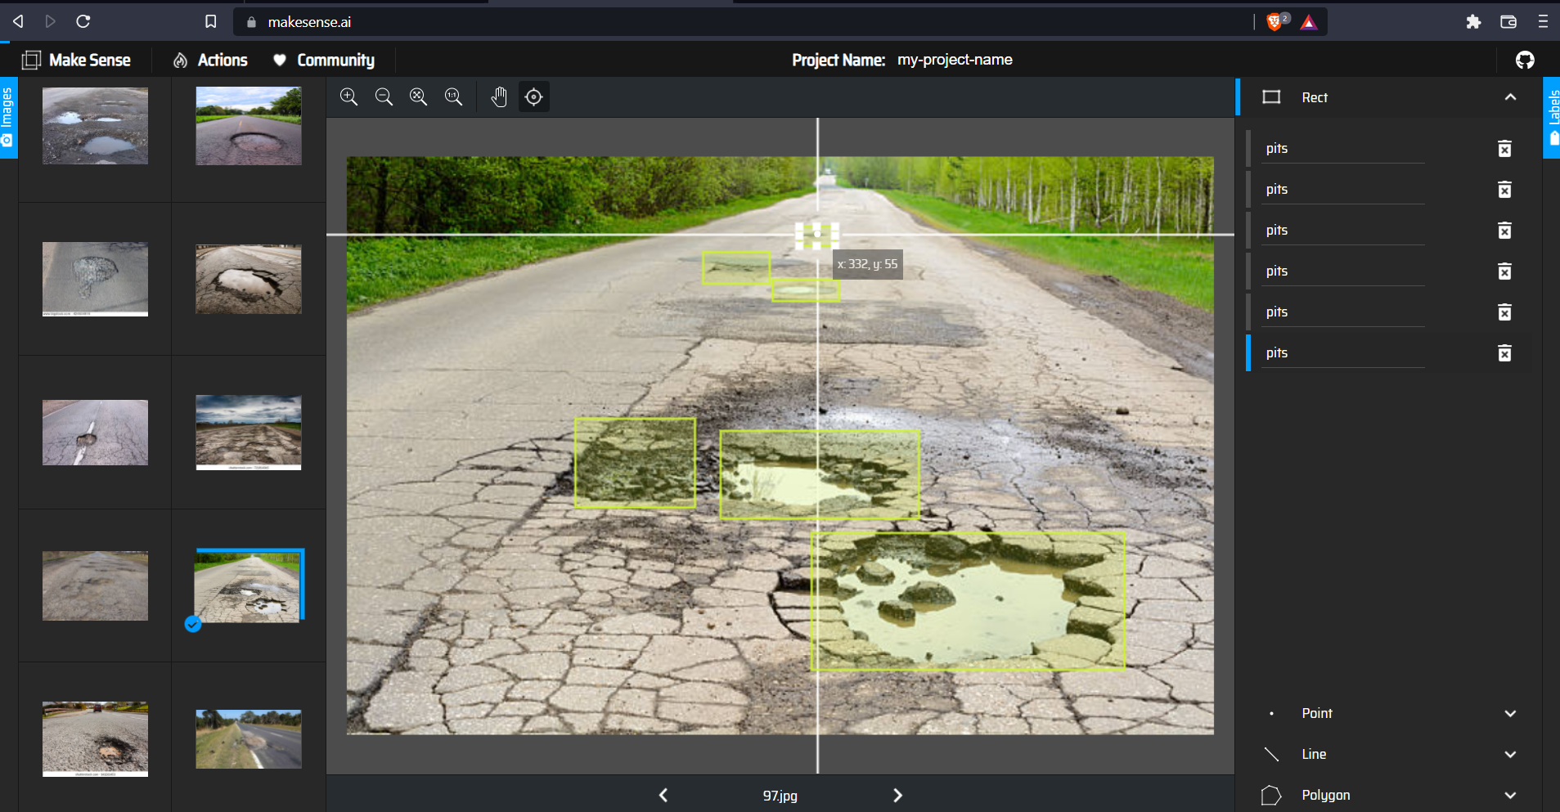
Dataset labelling
We have used an Application called MAKESENSE.AI .
This application is used for labelling the images in our dataset.
This labelling is helpful in training the model .

Slide 10
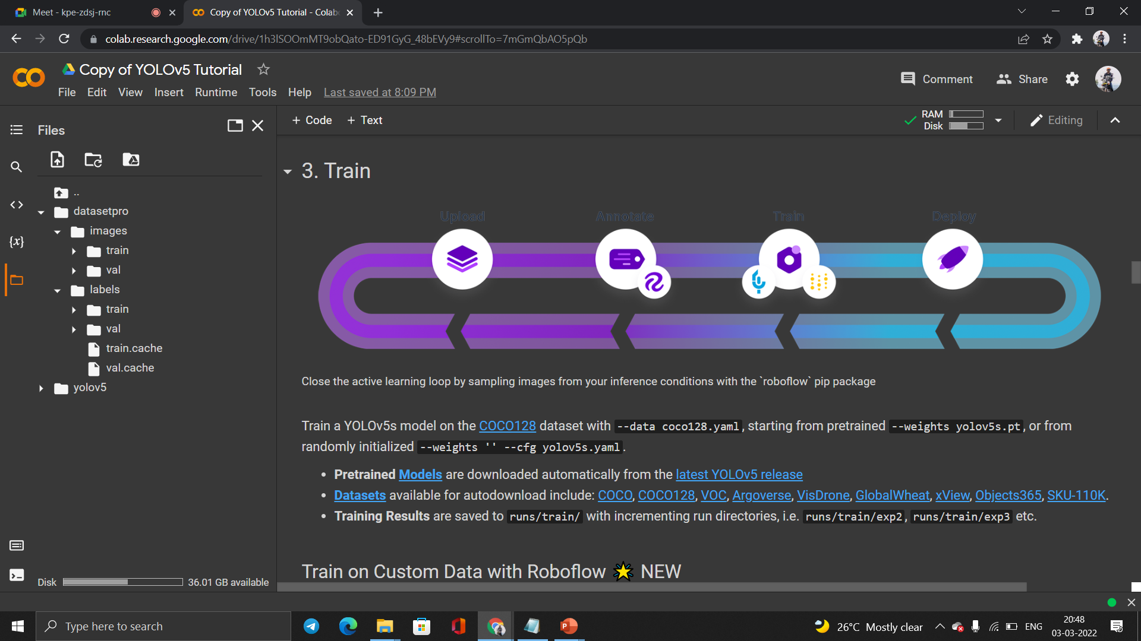
Training and validation
We have used google colab for training the yolov5 algorithm using the labelled images.
We have also validate these images in the same source.
https://colab.research.google.com/drive/1h3lSOOmMT9obQato-ED91GyG_48bEVy9#scrollTo=7mGmQbAO5pQb

